Slide 1

NETFLIX DATASET ANALYSIS
Dangeti Suryakala
INTERNSHIP_172663295366ea53f910591

Slide 2

PROBLEM STATEMENT
Netflix has become one of the most prominent global streaming platforms, continuously expanding its library with a mix of original productions and licensed content. However, with growing competition from platforms like Amazon Prime, Disney+, and regional OTT providers, Netflix must strategically analyze its content catalog to identify strengths, gaps, and opportunities.

Slide 3
Project Description *Dataset: ~7,789 records, 11 columns (2008–2021) *Attributes: Title, Director, Cast, Country, Release Date, Rating, Duration, *Category, Genre *Goal: Analyze trends in Netflix’s content and recommend strategies for future growth.

Slide 4

WHO ARE THE END USERS?
Netflix Management & Strategy Teams → For decision-making on content acquisition
Content Creators & Producers → To identify popular genres and trends
Market Analysts → To track OTT competition trends
Students/Researchers → For learning data analysis and visualization

Slide 5

Technology Used
Programming Language: Python – for data cleaning, analysis, and visualization.
Data Analysis Libraries: Pandas – for data manipulation and preprocessing. NumPy – for numerical operations and calculations.
Data Visualization Libraries: Matplotlib – for bar charts, line plots, and regression plots. Seaborn – for advanced statistical visualizations like boxplots and heatmaps. Plotly Express – for interactive visualizations (optional).
Development Environment: Jupyter Notebook / Google Colab – for coding and visualization.

Slide 6
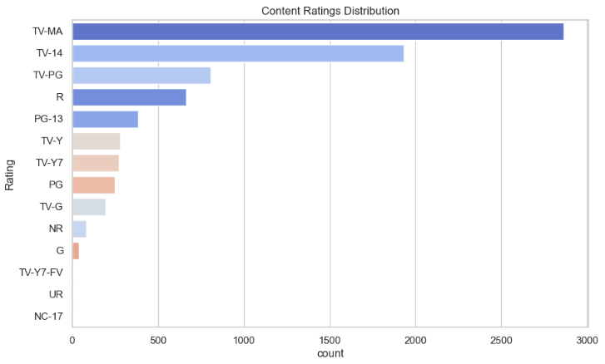
RESULTS1
Demo Link

Slide 7
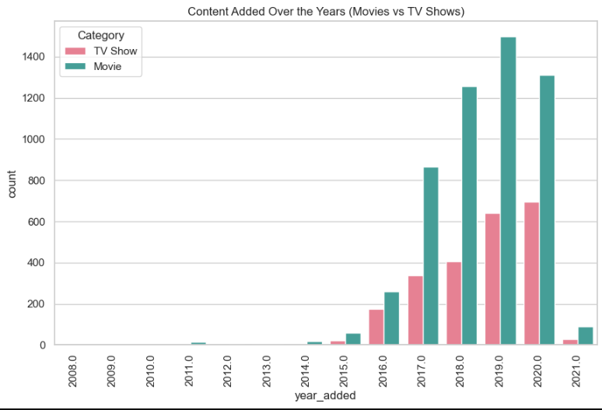
RESULTS2
Demo Link

Slide 8
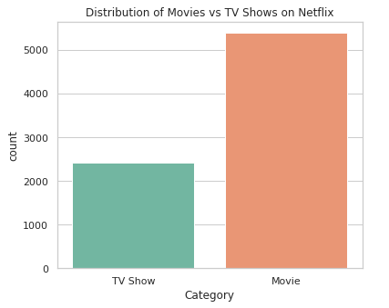
RESULTS3
Demo Link

Slide 9
GitHub repository
https://github.com/Suryakaladangeti/VOIS_AICTE_Oct2025_MajorProject_DangetiSuryakala
Demo Link

Slide 10

Getting started with Basics of Python Certificate

Slide 11

Data Visualization Certificate

Slide 12
Thank you
.
.

